Slide 1


CSCE 5640 Operating System Design Virtual Memory
Dr. Amar Maharjan
Computer Science and Engineering
University of North Texas
Slides (with some modifications) from:
Operating System Concepts 10 edition – Silberschatz, Galvin and Gagne © 2018
Notes:
Virtual: We will be using addresses that are beyond the capacity of memory.

Slide 2
Outline
Background
Demand Paging
Copy-on-Write
Page Replacement
Allocation of Frames
Thrashing
Notes:
Demand Paging: Load the page only on demand.

Slide 3
Background
Code needs to be in memory to execute, but entire program rarely used
Error code, unusual routines, large data structures
Entire program code not needed at same time
Consider ability to execute partially-loaded program
Program no longer constrained by limits of physical memory
Each program takes less memory while running -> more programs run at the same time
Increased CPU utilization and throughput with no increase in response time or turnaround time
Less I/O needed to load or swap programs into memory -> each user program runs faster
Notes:
Code must be loaded on the main memory to execute, but the entire code may not be required at the same time.

Slide 4
Virtual memory
Virtual memory – separation of user logical memory from physical memory
Only part of the program needs to be in memory for execution
Logical address space can therefore be much larger than physical address space
Allows address spaces to be shared by several processes
Allows for more efficient process creation
More programs running concurrently
Less I/O needed to load or swap processes

Slide 5
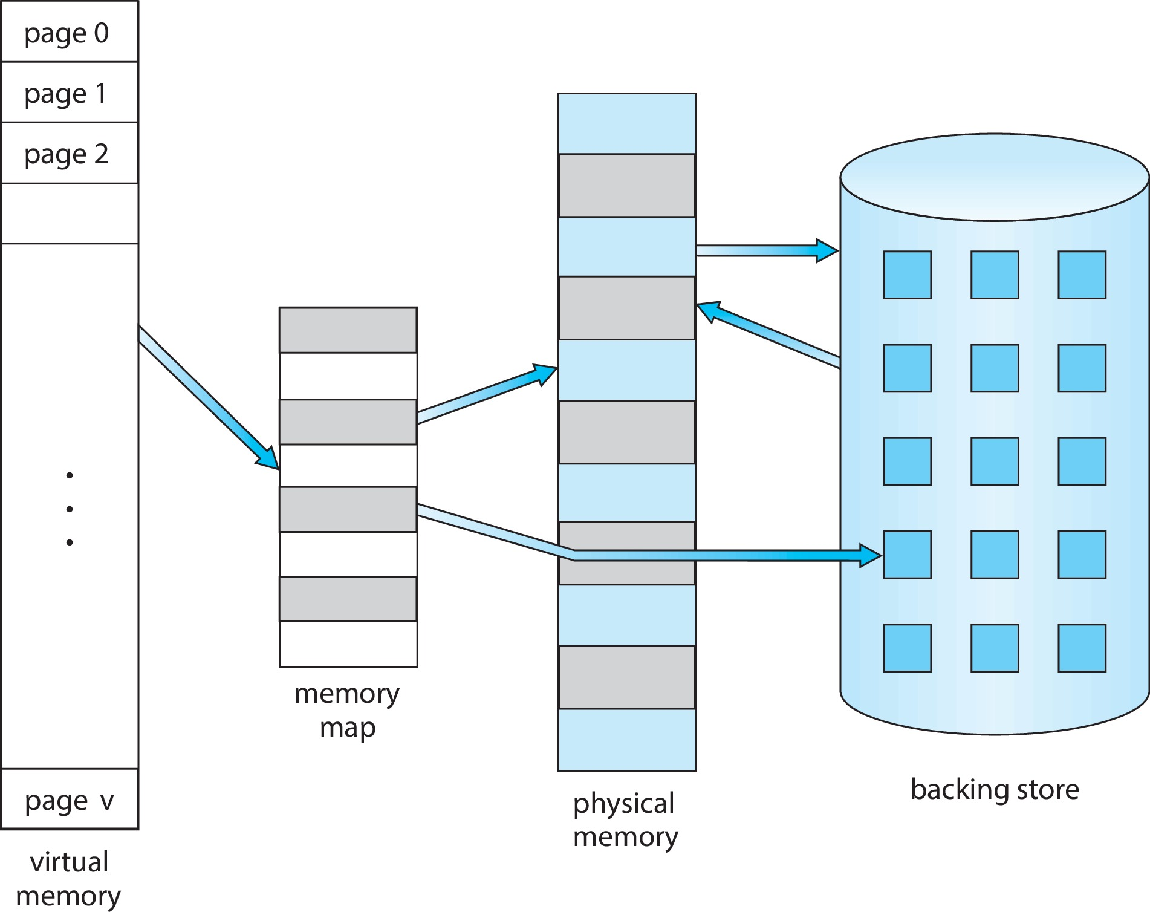
Virtual Memory vs. Physical Memory
Notes:
Memory maps can be anything, let's say it’s paging.
If certain pages are not available they will be loaded from the backing store into the frame and then executed, which is challenging.

Slide 6
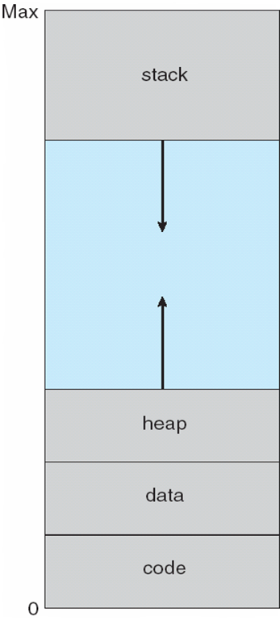
Virtual-address Space
Usually design logical address space for stack to start at Max logical address and grow “down” while heap grows “up”
Maximizes address space use
Unused address space between the two is hole
No physical memory needed until heap or stack grows to a given new page
Enables sparse address spaces with holes left for growth, dynamically linked libraries, etc.
System libraries shared via mapping into virtual address space
Pages can be shared during fork(), speeding process creation
Notes:
Heap: Dynamic memory allocation
Stack: Local variables, and function calls.
The large gap in the middle may not be required initially, it is only required during the dynamic memory allocation and function calls.

Slide 7
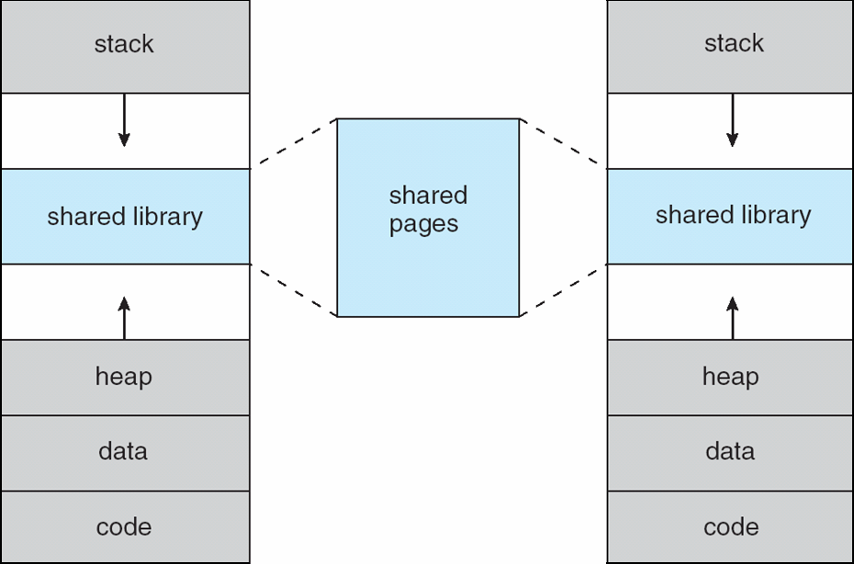
Shared Library Using Virtual Memory
Notes:
Both can use same frames.

Slide 8
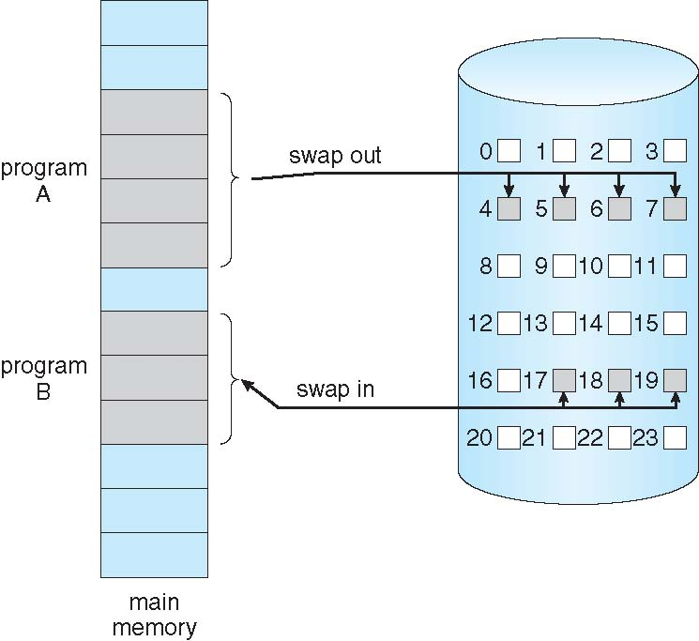
Demand Paging
Could bring entire process into memory at load time
Or bring a page into memory only when it is needed
Less I/O needed, no unnecessary I/O
Less memory needed
Faster response
More users
Similar to paging system with swapping (diagram on right)

Slide 9
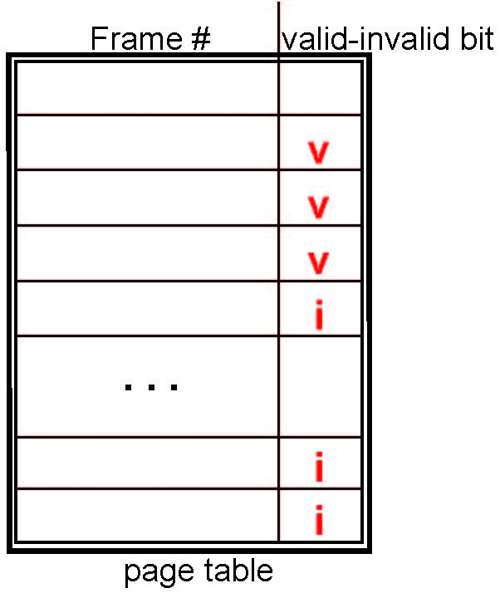
Valid-Invalid Bit
With each page table entry, a valid–invalid bit is associated (v ⇒ in-memory – memory resident, i ⇒ not-in-memory)
Initially valid–invalid bit is set to i on all entries
Example of a page table snapshot:
During MMU address translation, if valid–invalid bit in page table entry is i ⇒ page fault
Notes:
‘v’, the frame is already loaded to the main memory.
‘i’ means not in the main memory; we need to load a page from the backing source.

Slide 10
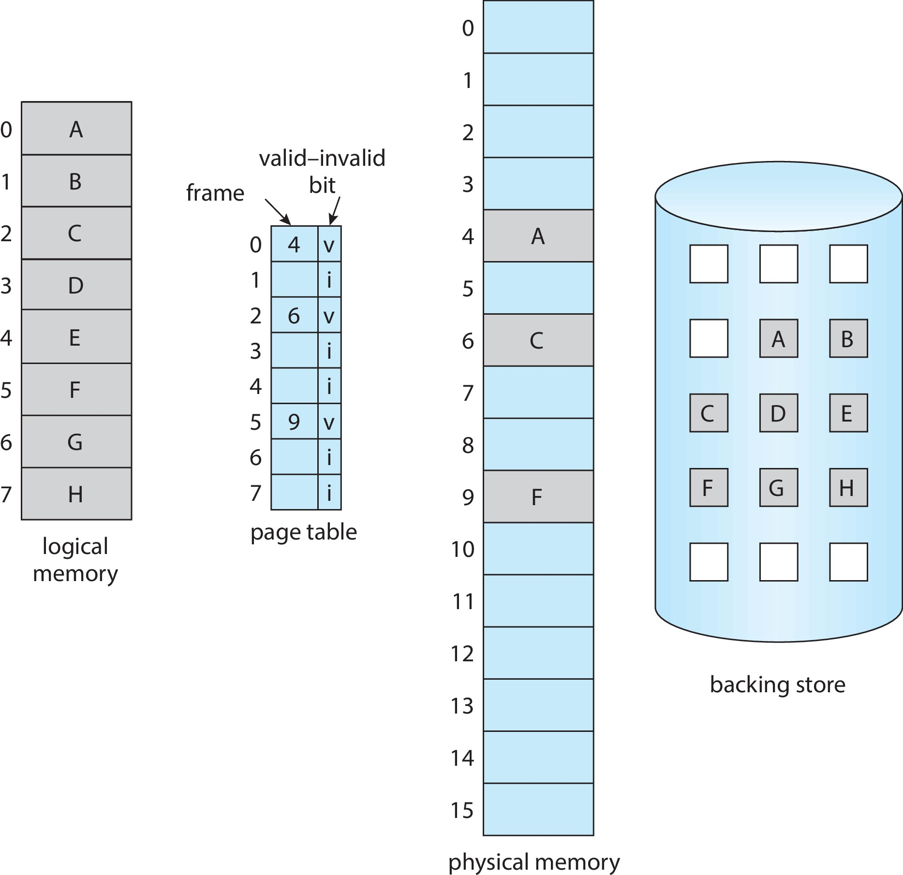
Page Table When Some Pages Are Not in Main Memory
Notes:
All paged information is in the backing store.

Slide 11
Steps in Handling Page Fault
If there is a reference to a page, first reference to that page will trap to operating system
Page fault
Operating system looks at another table to decide:
Invalid reference ⇒ abort
Just not in memory
Find free frame
Swap page into frame via scheduled disk operation
Reset tables to indicate page now in memory Set validation bit = v
Restart the instruction that caused the page fault
Notes:
Let's say we have a ‘Page Fault’.

Slide 12
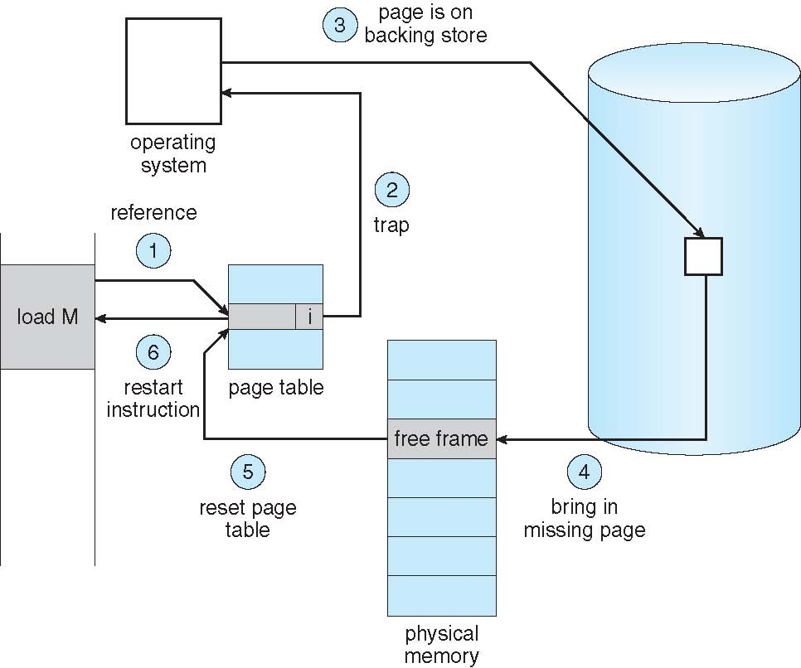
Steps in Handling Page Fault (contd.)

Slide 13
Aspects of Demand Paging
Extreme case – start process with no pages in memory
OS sets instruction pointer to first instruction of process, non-memory-resident -> page fault
And for every other process pages on first access
Pure demand paging
Actually, a given instruction could access multiple pages -> multiple page faults
Consider fetch and decode of instruction which adds 2 numbers from memory and stores result back to memory
Pain decreased because of locality of reference
Hardware support needed for demand paging
Page table with valid / invalid bit
Secondary memory (swap device with swap space)
Instruction restart
Notes:
The secondary memory is usually a high-speed disk or NVM device. It is known as the swap device, and the section of storage used for this purpose is known as the swap space.
Space locality: Surrounding variables may also be used.
Time locality: If we used a variable, there may be a chance that you will use the variable soon.

Slide 14
Free-Frame List
When a page fault occurs, the operating system must bring the desired page from secondary storage into main memory.
Most operating systems maintain a free-frame list -- a pool of free frames for satisfying such requests.
Operating system typically allocate free frames using a technique known as zero-fill-on-demand -- the content of the frames zeroed-out before being allocated.
When a system starts up, all available memory is placed on the free-frame list.
Notes:
When the OS needs free frames, it will check the linked list of free frames.
Before providing the free frame to a process, all the content of that frame will be cleared out (zeroed out).

Slide 15
Stages in Demand Paging – Worse Case
Trap to the operating system
Save the user registers and process state
Determine that the interrupt was a page fault
Check that the page reference was legal and determine the location of the page on the disk
Issue a read from the disk to a free frame:
Wait in a queue for this device until the read request is serviced
Wait for the device seek and/or latency time
Begin the transfer of the page to a free frame

Slide 16
Stages in Demand Paging – Worse Case (contd.)
While waiting, allocate the CPU to some other user
Receive an interrupt from the disk I/O subsystem (I/O completed)
Save the registers and process state for the other user
Determine that the interrupt was from the disk
Correct the page table and other tables to show page is now in memory
Wait for the CPU to be allocated to this process again
Restore the user registers, process state, and new page table, and then resume the interrupted instruction
Notes:
All the steps may not happen.

Slide 17
Performance of Demand Paging
Three major activities
Service the interrupt – careful coding means just several hundred instructions needed
Read the page – lots of time
Restart the process – again just a small amount of time
Page Fault Rate 0 ≤ p ≤ 1
if p = 0 no page faults
if p = 1, every reference is a fault
Effective Access Time (EAT)
EAT = (1 – p) x memory access
+ p (page fault overhead
+ swap page out
+ swap page in )
Notes:
Read the page: Requires a lot of time, because of many I/O operations.
The other 2 can be implemented quickly.
0: No page fault
1: 100% page fault.
p: Fault rate
1-p: No fault rate

Slide 18
Demand Paging Example
Memory access time = 200 nanoseconds
Average page-fault service time = 8 milliseconds
EAT = (1 – p) x 200 + p (8 milliseconds)
= (1 – p) x 200 + p x 8,000,000
= 200 + p x 7,999,800
If want performance degradation < 10 percent
220 > 200 + 7,999,800 x p 20 > 7,999,800 x p
p < .0000025
< one page fault in every 400,000 memory accesses
Notes:
8 milliseconds = 8,000,000 nanoseconds.

Slide 19
Demand Paging Optimizations
Swap space I/O faster than file system I/O even if on the same device
Swap allocated in larger chunks; less management needed than file system
On option: Copy entire process image to swap space at process load time
Then page in and out of swap space
A second option: Demand page in from program binary on disk, but discard rather than paging out when freeing frame
Still need to write to swap space
Pages not associated with a file (like stack and heap) – anonymous memory
Pages modified in memory but not yet written back to the file system
Mobile systems
Typically, don’t support swapping
Instead, demand page from file system and reclaim read-only pages (such as code) from applications if memory becomes constrained.
Notes:
Let's copy all the pages into swap space, and all the swapping from now is not in the swap space.
Certain pages can be discarded without writing back because they are read-only.
Stack and heap must be written.

Slide 20
Copy-on-Write
Copy-on-Write (COW) allows both parent and child processes to initially share the same pages in memory
If either process modifies a shared page, only then is the page copied
COW allows more efficient process creation as only modified pages are copied
In general, free pages are allocated from a pool of zero-fill-on-demand pages
Pool should always have free frames for fast demand page execution
vfork()variation on fork()system call has parent suspend and child using copy-on-write address space of parent
Designed to have child call exec()
Very efficient
Notes:
We will create only when we try to write on that page.
We will not create separate memories for children and parents; they will share.

Slide 21
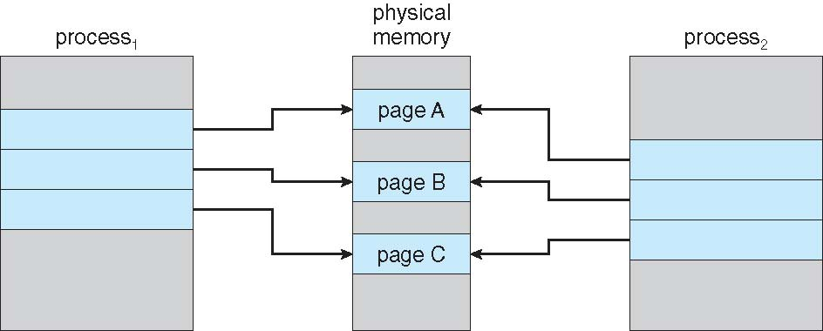
Before Process 1 Modifies Page C

Slide 22
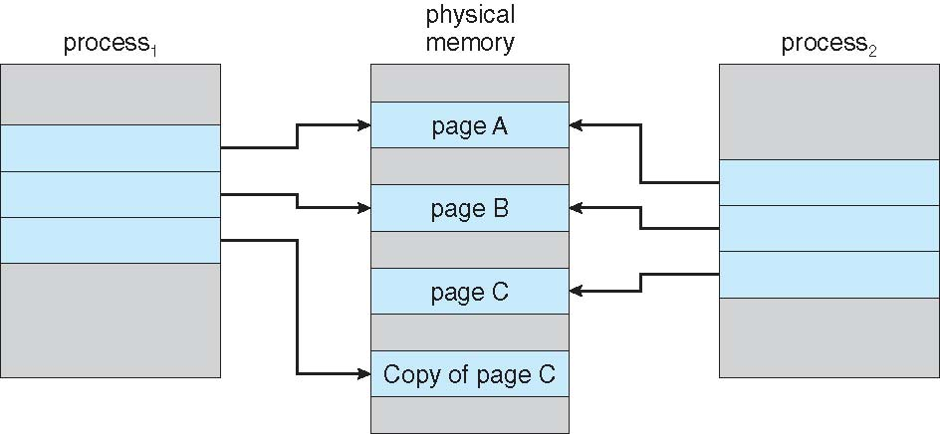
After Process 1 Modifies Page C
Notes:
If both processes try to update a single page, then a new copy of the page is created.

Slide 23
What Happens if There is no Free Frame?
Used up by process pages
Also, in demand from the kernel, I/O buffers, etc.
How much to allocate to each?
Page replacement – find some page in memory, but not really in use, page it out
Algorithm – terminate? swap out? replace the page?
Performance – want an algorithm which will result in minimum number of page faults
Same page may be brought into memory several times

Slide 24
Page Replacement
Prevent over-allocation of memory by modifying page-fault service routine to include page replacement
Use modify (dirty) bit to reduce overhead of page transfers – only modified pages are written to disk
Page replacement completes separation between logical memory and physical memory – large virtual memory can be provided on a smaller physical memory
Notes:
Dirty bit: True or False
When every a variable is updates, then the page related to that variable is also updated.
If the page is updated then we need to write back the content into the swap space.
Not the perfect solution.
If we increase our degree of multiprogramming, we are over-allocating memory.
Over-allocation of memory manifests itself as follows. While a process is executing, a page fault occurs.
The operating system determines where the desired page is residing on secondary storage but then finds that there are no free frames on the free-frame list; all memory is in use.

Slide 25
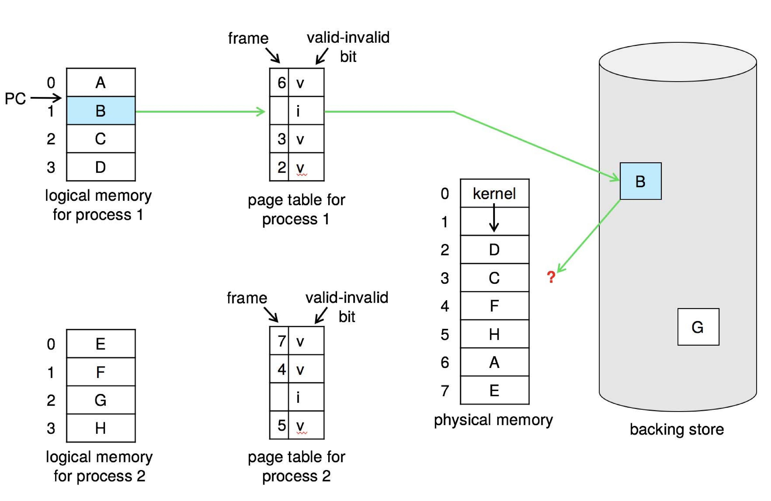
Need For Page Replacement
Notes:
PC: Program Counter
i: Invalid: This page is not loaded.
A backing store is sometimes also known as a swap space.

Slide 26
Basic Page Replacement
Find the location of the desired page on disk
Find a free frame: - If there is a free frame, use it - If there is no free frame, use a page replacement algorithm to select a victim frame - Write victim frame to disk if dirty
Bring the desired page into the (newly) free frame; update the page and frame tables
Continue the process by restarting the instruction that caused the trap
Note now potentially 2-page transfers for page fault – increasing EAT
Notes:
2-page transfers: One for writing back if it is modified (Swap out), one for loading back (Swap in).
We want to reduce as much as possible, so we need to pick the replacement algorithm which will reduce.

Slide 27
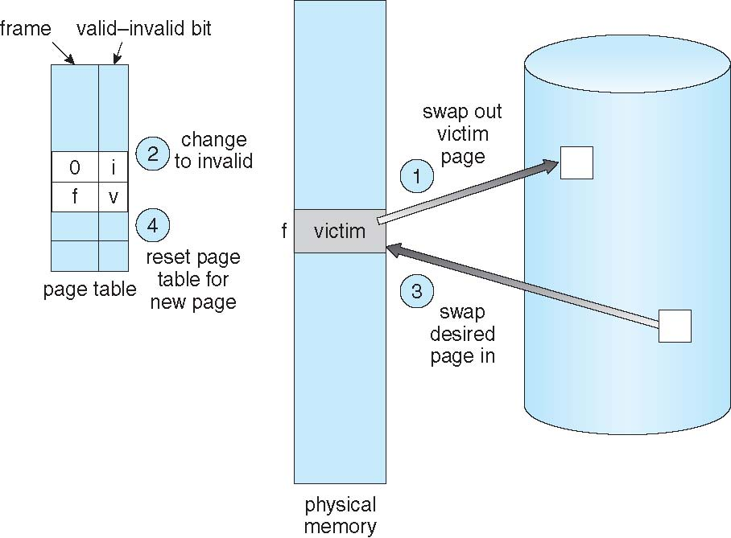
Page Replacement
Notes:
Mark the old entry to ‘i’, And the new entry to ‘v’
0: Removing content from the page table.

Slide 28
Page and Frame Replacement Algorithms
Frame-allocation algorithm determines
How many frames to give each process
Page-replacement algorithm
Want lowest page-fault rate on both first access and re-access
Evaluate algorithm by running it on a particular string of memory references (reference string) and computing the number of page faults on that string
String is just page numbers, not full addresses
Repeated access to the same page does not cause a page fault
Results depend on number of frames available
In all our examples, the reference string of referenced page numbers is (for a memory with three frames)
7, 0, 1, 2, 0, 3, 0, 4, 2, 3, 0, 3, 0, 3, 2, 1, 2, 0, 1, 7, 0, 1
Notes:
No two consequent page numbers are the same.
We will use only one, even if it is repeating. Ex: 1,4,4,3,2 == 1,4,3,2

Slide 29
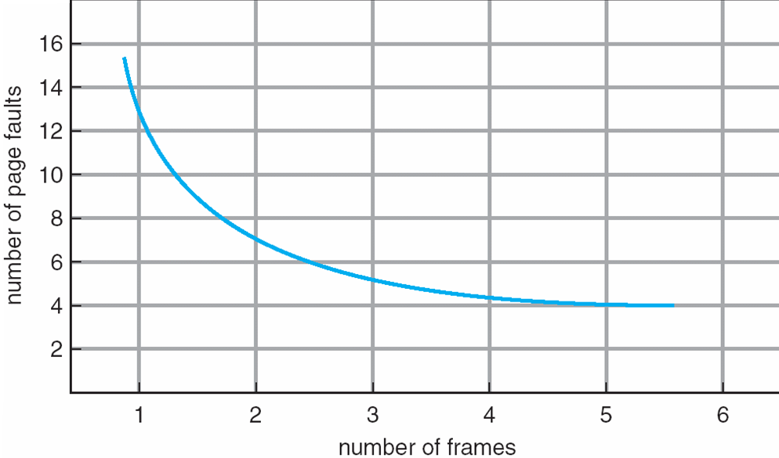
Graph of Page Faults Versus the Number of Frames
Notes:
If we increase the number of frames, then the error decreases.
There can be a six-zag line also.

Slide 30
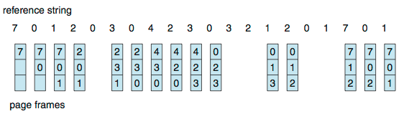
First-In-First-Out (FIFO) Page Replacement
Reference string: 7,0,1,2,0,3,0,4,2,3,0,3,0,3,2,1,2,0,1,7,0,1
3 frames (3 pages can be in memory at a time per process)
Can vary by reference string: consider 1,2,3,4,1,2,5,1,2,3,4,5
Adding more frames can cause more page faults!
Belady’s Anomaly
How to track ages of pages?
Just use a FIFO queue
Notes:
Every vertical bar represents page fault.
5th 0: Hit, that’s why we don't have page fault.

Slide 31
FIFO Illustrating Belady’s Anomaly

Slide 32
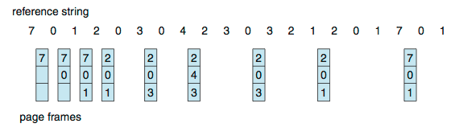
Optimal Page Replacement
Replace page that will not be used for longest period of time
9 is optimal for the example
How do you know this?
Can’t read the future
Used for measuring how well your algorithm performs
Notes:
Usually, difficult to implement because we need a future reference.
This can be used for comparison and theoretical approaches.
9 page faults, better than FIFO.

Slide 33
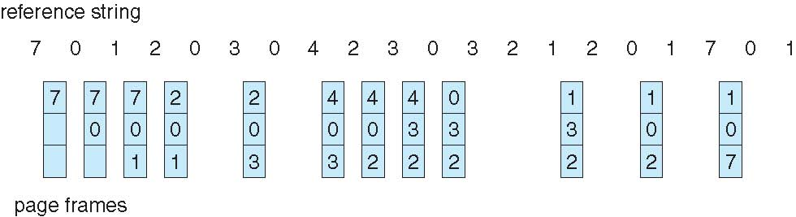
Least Recently Used (LRU) Page Replacement
Use past knowledge rather than future
Replace page that has not been used in the most amount of time
Associate time of last use with each page
12 faults – better than FIFO but worse than OPT (Optical Page Replacement)
Generally good algorithm and frequently used
But how to implement?
Notes:
Mostly we use this.
We look at the past.

Slide 34
LRU Algorithm (contd.)
Counter implementation
Every page entry has a counter; every time page is referenced through this entry, copy the clock into the counter
When a page needs to be changed, look at the counters to find smallest value
Search through table needed
Stack implementation
Keep a stack of page numbers in a double link form:
Page referenced:
move it to the top
requires 6 pointers to be changed
But each update more expensive
No search for replacement
Notes:
Every time we look at the page, then we update the data and time for that page.
Whenever we reference a page, it will be moved to the top of the stack.
The victims will be bottom pages (Least recently used)
If we use an array instead of a double-linked list, it will be difficult to move items to the top.

Slide 35
LRU Algorithm (contd.)
LRU and OPT are cases of stack algorithms that don’t have Belady’s Anomaly
Use of a stack to record most recent page references

Slide 36
LRU Approximation Algorithms
LRU needs special hardware and still slow
Reference bit
With each page associate a bit, initially = 0
When page is referenced, bit set to 1
Replace any with reference bit = 0 (if one exists)
We do not know the order, however
Notes:
We don't know whether LRU will perform well every time or not.
If we want quick results, we need to use hardware for this. Software implementation is taught, and the result is slow.
There are some things why LRU is not used.
Victim: Pick whose reference bit is 0.
We don’t know the order of the page, and to store that is difficult, so we only stored the reference (yes, or no).

Slide 37
LRU Approximation Algorithms (contd.)
Second-chance algorithm
Generally, FIFO, plus hardware-provided reference bit
Clock replacement
If page to be replaced has
Reference bit = 0 -> replace it
reference bit = 1 then:
set reference bit 0, leave page in memory
replace next page, subject to same rules
Notes:
Giving a second chance of the page is referenced.
We will not select the bit=1 page immediately; we will change it to 0 and then move on, then, in the future, we may choose it.

Slide 38
Second-chance Algorithm

Slide 39
Enhanced Second-Chance Algorithm
Improve algorithm by using reference bit and modify bit (if available) in concert
Take ordered pair (reference, modify):
(0, 0) neither recently used not modified – best page to replace
(0, 1) not recently used but modified – not quite as good, must write out before replacement
(1, 0) recently used but clean – probably will be used again soon
(1, 1) recently used and modified – probably will be used again soon and need to write out before replacement
When page replacement called for, use the clock scheme but use the four classes replace page in the lowest non-empty class
Might need to search circular queue several times
Notes:
Here we also consider modifying bit, apart from reference bit.
We always try to take in the order class 1,2,3,4.
Search the page table multiple times.
This is better that second chance because it has more content/information to select the victim.
Notice that we may have to scan the circular queue several times before we find a page to be replaced.
The major difference between this algorithm and the simpler clock algorithm is that here we give preference to those pages that have been modified in order to reduce the number of I/Os required.

Slide 40
Counting-Based Page Replacement
Keep a counter of the number of references that have been made to each page
Not common
Lease Frequently Used (LFU) Algorithm:
Replaces page with smallest count
Most Frequently Used (MFU) Algorithm:
Based on the argument that the page with the smallest count was probably just brought in and has yet to be used
Notes:
LFU
Take the page with lease frequency.
MFU
Take the most frequently used page because it assumes that it is used enough and may not be used on the future.

Slide 41
Page-Buffering Algorithms
Other procedures are often used in addition to a specific page-replacement algorithm.
Keep a pool of free frames, always
The desired page is read into a free frame from the pool before the victim is written out.
This procedure allows the process to restart as soon as possible, without waiting for the victim page to be written out.
When the victim is later written out, its frame is added to the free-frame pool.
Possibly, keep list of modified pages
Whenever the paging device is idle, a modified page is selected and is written to secondary storage. Its modify bit is then reset.
Possibly, keep free frame contents intact and note what is in them
If referenced again before reused, no need to load contents again from disk
Generally useful to reduce penalty if wrong victim frame selected
Notes:
Certain frames are always free-maintained by OS.
Select the frame from the free pool, and then when we select a victim, give the free frame to the free frame list(Now the victim space is free), and the number of free frames is constant.

Slide 42
Applications and Page Replacement
All of these algorithms have OS guessing about future page access
Some applications have better knowledge – i.e., databases
Memory intensive applications can cause double buffering
OS keeps copy of page in memory as I/O buffer
Application keeps page in memory for its own work
Operating system can give direct access to the disk, getting out of the way of the applications
Raw disk mode
Bypasses buffering, locking, etc.

Slide 43
Allocation of Frames
Each process needs minimum number of frames
Maximum of course is total frames in the system
Two major allocation schemes
fixed allocation
priority allocation
Notes:
Higher priority = Higher frames

Slide 44
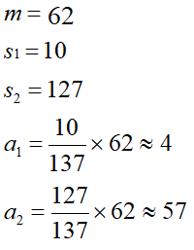
Fixed Allocation
Equal allocation – For example, if there are 100 frames (after allocating frames for the OS) and 5 processes, give each process 20 frames
Keep some as free frame buffer pool
Proportional allocation – Allocate according to the size of process
Dynamic as degree of multiprogramming, process sizes change
Notes:
Number of frames: 62
Process 1 size = 10
Process 2 size = 127
Total= 137
4+57 = 61 but we have 62 so its approx.

Slide 45
Global vs. Local Allocation
Global replacement – process selects a replacement frame from the set of all frames; one process can take a frame from another
But then process execution time can vary greatly
But greater throughput so more common
Local replacement – each process selects from only its own set of allocated frames
More consistent per-process performance
But possibly under-utilized memory

Slide 46
Reclaiming Pages
A strategy to implement global page-replacement policy
All memory requests are satisfied from the free-frame list, rather than waiting for the list to drop to zero before we begin selecting pages for replacement,
Page replacement is triggered when the list falls below a certain threshold.
This strategy attempts to ensure there is always sufficient free memory to satisfy new requests.
Notes:
Most of the time, we select victim only when there is a page fault (That means we don’t have available frames).
OS checks and reclaims the pages will be triggered at certain locations, so that when page fault happens we can serve it as quick as possible
With this approach, we satisfy all memory requests from the free-frame list, but rather than waiting for the list to drop to zero before we begin selecting pages for replacement, we trigger page replacement when the list falls below a certain threshold.
This strategy attempts to ensure there is always sufficient free memory to satisfy new requests.

Slide 47
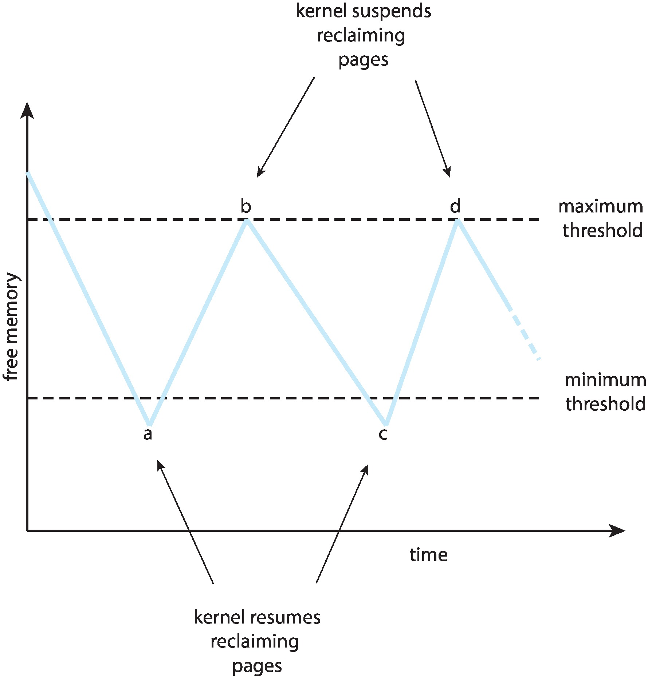
Reclaiming Pages Example

Slide 48
Thrashing
If a process does not have “enough” pages, the page-fault rate is very high
Page fault to get page
Replace existing frame
But quickly need replaced frame back
This leads to:
Low CPU utilization
Operating system thinking that it needs to increase the degree of multiprogramming
Another process added to the system

Slide 49
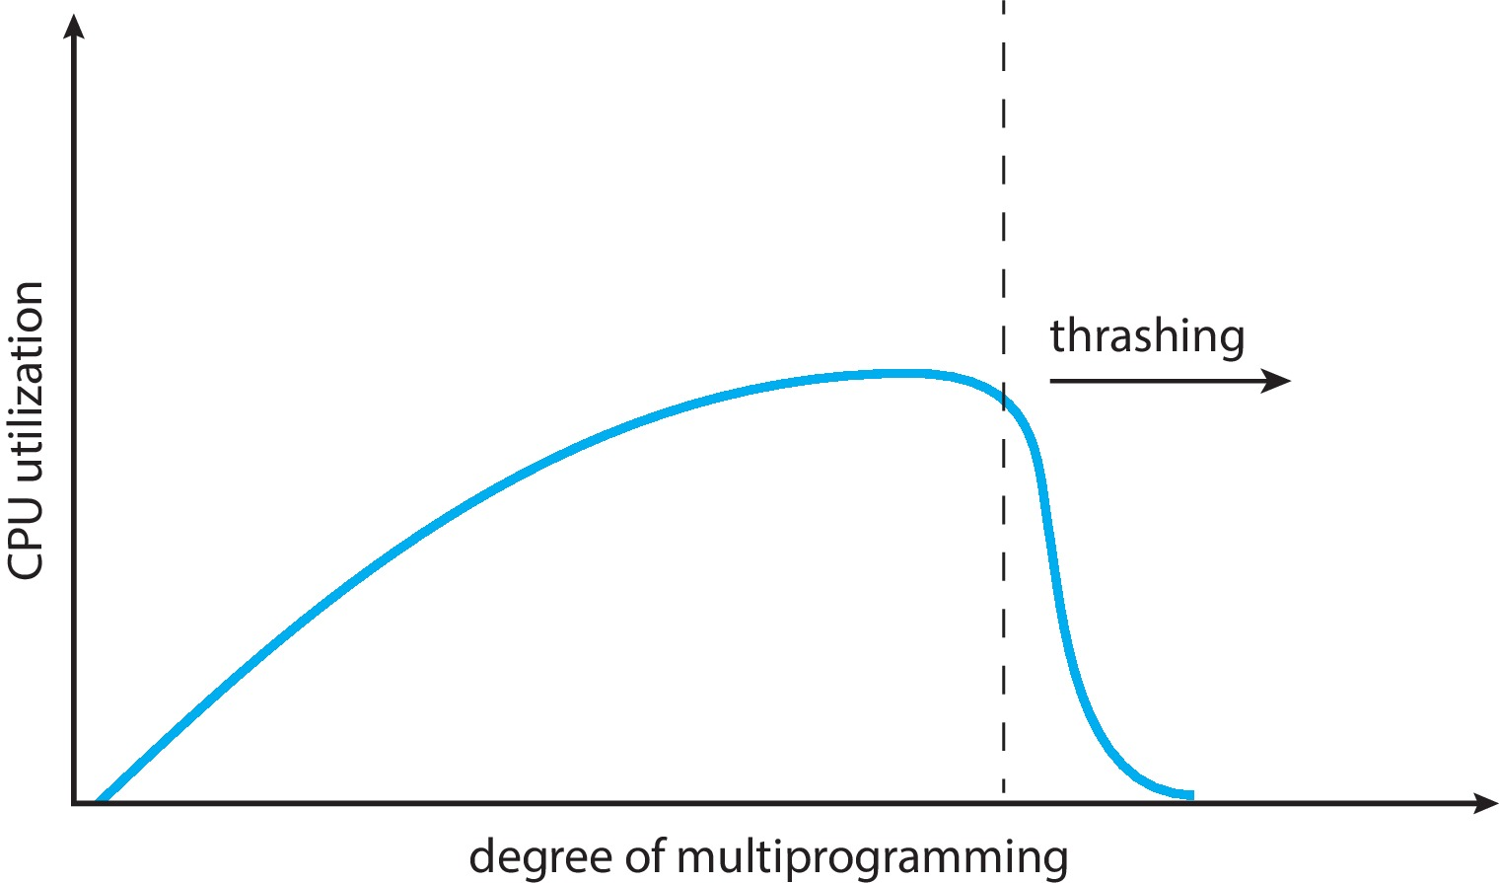
Thrashing (contd.)
Thrashing. A process is busy swapping pages in and out

Slide 50
Demand Paging and Thrashing
To prevent thrashing, we must provide a process with as many frames as it needs.
Why does demand paging work?
Locality model
Process migrates from one locality to another
Localities may overlap
Why does thrashing occur?
Σ size of locality > total memory size
Notes:
How can we computer size of each locality?
The locality model states that, as a process executes, it moves from locality to locality.
A locality is a set of pages that are actively used together.
A running program is generally composed of several different localities, which may overlap.
Limit effects by using local or priority page replacement

Slide 51
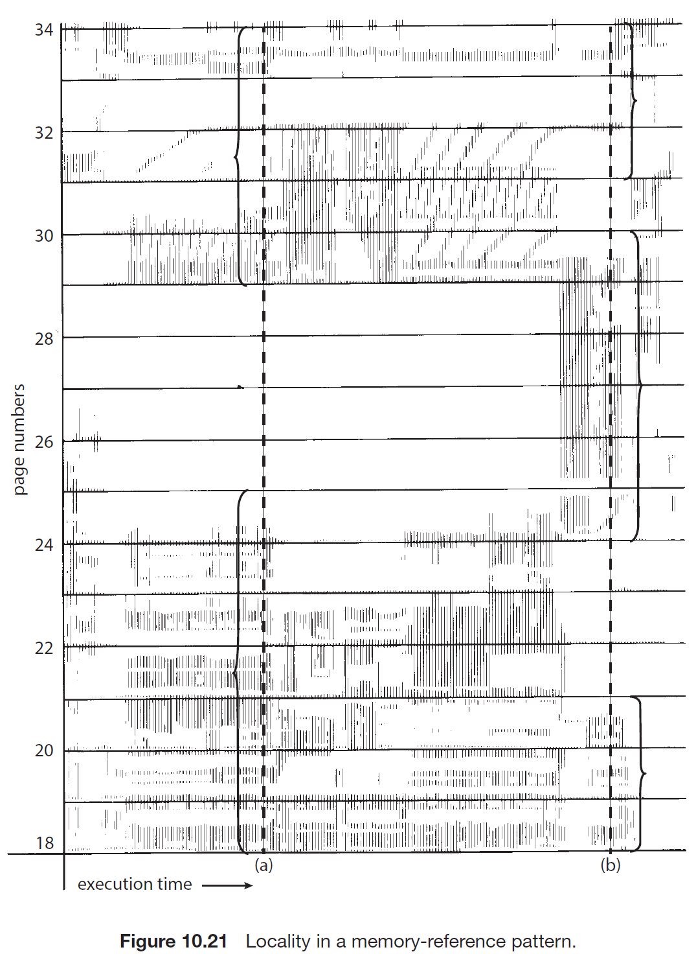
Locality In A Memory-Reference Pattern

Slide 52
Locality In A Memory-Reference Pattern
At time (a), the locality is the set of pages:
{18, 19, 20, 21, 22, 23, 24, 29, 30, 33}.
At time (b), the locality changes to:
{18, 19, 20, 24, 25, 26, 27, 28, 29, 31, 32, 33}.
Notice the overlap, as some pages (for example, 18, 19, and 20) are part of both localities.

Slide 53
Working-Set Model
The working-set model is based on the assumption of locality.
This model uses a parameter, Δ, to define the working-set window. The idea is to examine the most recent Δ page references.
Δ ≡ working-set window ≡ a fixed number of page references Example: 10,000 instructions
WSS_{i} (working set size of Process P_{i}) = total number of pages referenced in the most recent Δ (varies in time)
if Δ too small will not encompass entire locality
if Δ too large will encompass several localities
if Δ = ∞ ⇒ will encompass entire program
D = Σ WSS_{i} ≡ total demand frames
If the total demand is greater than the total number of available frames (D > m), thrashing will occur, because some processes will not have enough frames.
Notes:
Delta means a small value.
Thus, process i needs WSSi frames. If the total demand is greater than the total number of available frames (D > m), thrashing will occur, because some processes will not have enough frames.

Slide 54
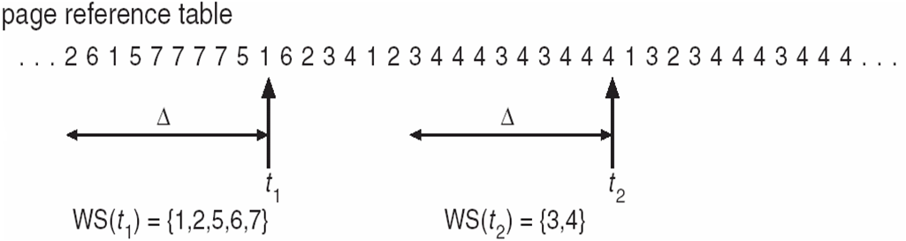
Working-Set Model (Cont.)
if D > m ⇒ Thrashing
Policy if D > m, then suspend or swap out one of the processes
Notes:
From that t1, and t2, we count ten previous pages, and we find the unique locations.
Which frame does not matter, but number matters.
At t1, we need five free frames, and at t2, we only need two free frames

Slide 55
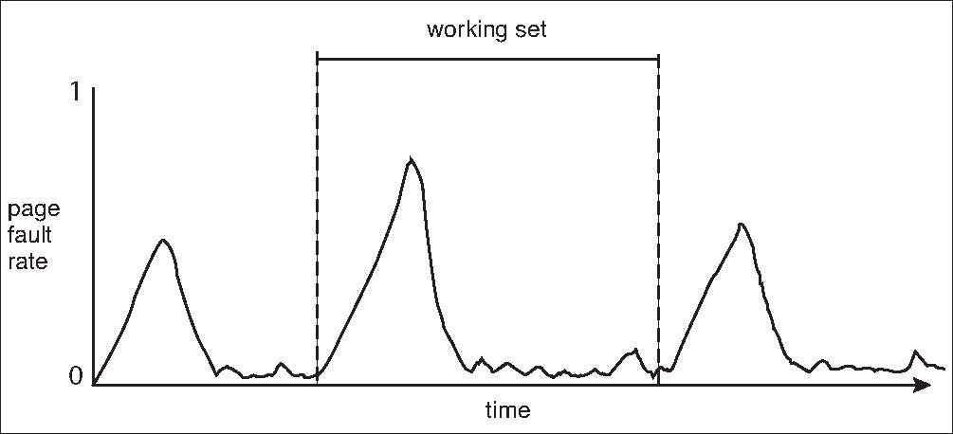
Working Sets and Page Fault Rates
Direct relationship between working set of a process and its page-fault rate
Working set changes over time
Peaks and valleys over time

Slide 56
Page-Fault Frequency
More direct approach than WSS
Establish “acceptable” page-fault frequency (PFF) rate and use local replacement policy
If actual rate too low, process loses frame
If actual rate too high, process gains frame
Notes:
As with the working-set strategy, we may have to swap out a process.
If the page-fault rate increases and no free frames are available, we must select some process and swap it out to backing store.
The freed frames are then distributed to processes with high page-fault rates.

